Slide 1
Apache Hadoop

Slide 2

Historical Review of Big Data

Slide 3
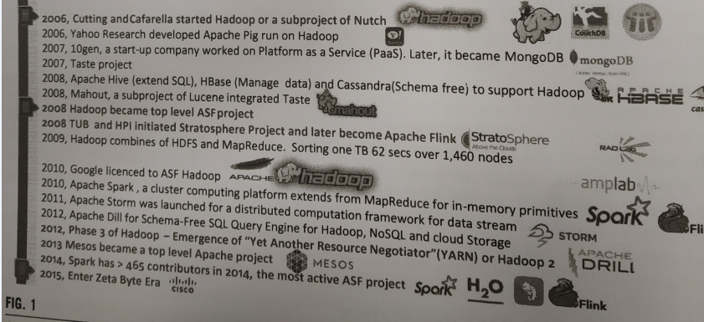

Slide 4
Apache Hadoop
Apache Hadoop is an open source software framework for storage and large scale processing of data-sets on clusters of commodity hardware.
Hadoop was created by Doug Cutting and Mike Cafarella in 2005.

Slide 5

Doug Cutting , who was working at Yahoo! at the time
He named the project after his son's toy elephant.
Cutting's son was 2 years old at the time and just beginning to talk. He called his beloved stuffed yellow elephant "Hadoop"

Slide 6
The Apache Hadoop framework modules
Hadoop Common: contains libraries and utilities needed by other Hadoop modules
Hadoop Distributed File System (HDFS): a distributed file-system that stores data on the commodity machines, providing very high aggregate bandwidth across the cluster
Hadoop YARN: a resource-management platform responsible for managing compute resources in clusters and using them for scheduling of users' applications
Hadoop MapReduce: a programming model for large scale data processing

Slide 7
Hadoop Distributed file system
HDFS is a filesystem designed for storing very large files with streaming data access patterns, running on clusters of commodity hardware

Slide 8
HDFS is not good fit for following
Low-latency data access
Lots of small files
Multiple writers and arbitrary file modifications

Slide 9
HDFS concepts
Block size
HDFS block size
Difference between HDFS and other file system
Why is a block size in HDFS so large?

Slide 10
HDFS services
Name Node
Secondary Name node
Job Tracker
Data Node
Task Tracker

Slide 11

Name Node
File.txt :440 MB
a.txt : 1,2
b.txt: 3
c.txt : 5
d.txt :7
Request
Client
Acknowledgement 1,3,5,7
b.txt
File.txt : input file
440MB : File size
a.txt
Data Node
1
Data Node
2
Data Node
3
Data Node
4
Input Splits
a.txt : 128 MB
b.txt : 128 MB
c.txt : 128 MB
d.txt : 56 MB
c.txt
d.txt
Data Node
5
Data Node
6
Data Node
7
Data Node
8

Slide 12
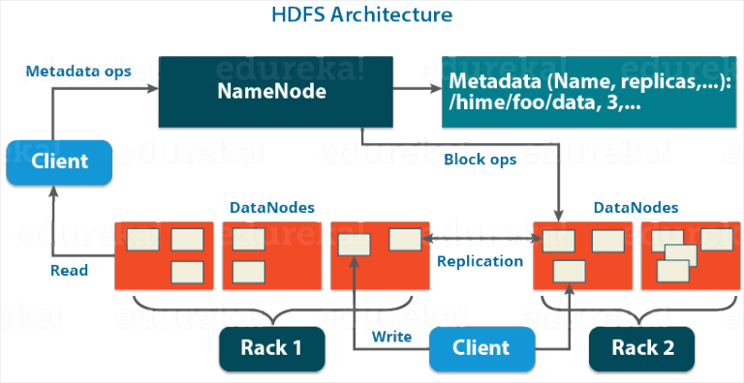
HDFS Architecture

Slide 13
NameNode
NameNode is the master node in the Apache Hadoop HDFS Architecture that maintains and manages the blocks present on the DataNodes (slave nodes).
NameNode is a very highly available server that manages the File System Namespace and controls access to files by clients.

Slide 14
Functions of Namenode
It is the master daemon that maintains and manages the DataNodes (slave nodes)
It records the metadata of all the files stored in the cluster
FsImage: It contains the complete state of the file system namespace since the start of the NameNode.
EditLogs: It contains all the recent modifications made to the file system with respect to the most recent FsImage.

Slide 15
It records each change that takes place to the file system metadata.
It regularly receives a Heartbeat and a block report from all the DataNodes in the cluster to ensure that the DataNodes are live.
It keeps a record of all the blocks in HDFS and in which nodes these blocks are located.
The NameNode is also responsible to take care of the replication factor of all the blocks which we will discuss in detail later in this HDFS tutorial blog.
In case of the DataNode failure, the NameNode chooses new DataNodes for new replicas, balance disk usage and manages the communication traffic to the DataNodes.

Slide 16
Data Nodes
DataNodes are the slave nodes in HDFS. Unlike NameNode, DataNode is a commodity hardware, that is, a non-expensive system which is not of high quality or high-availability.

Slide 17
Functions of Data Node
These are slave daemons or process which runs on each slave machine.
The actual data is stored on DataNodes.
The DataNodes perform the low-level read and write requests from the file system’s clients.
They send heartbeats to the NameNode periodically to report the overall health of HDFS, by default, this frequency is set to 3 seconds.

Slide 18
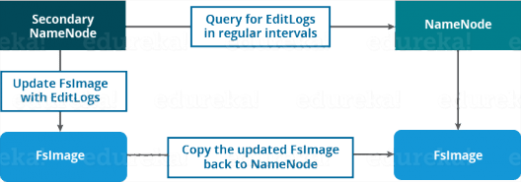
Secondary NameNode
Apart from these two daemons, there is a third daemon or a process called Secondary NameNode. The Secondary NameNode works concurrently with the primary NameNode as a helper daemon.

Slide 19
Functions of Secondary NameNode
The Secondary NameNode is one which constantly reads all the file systems and metadata from the RAM of the NameNode and writes it into the hard disk or the file system.
It is responsible for combining the EditLogs with FsImage from the NameNode.
It downloads the EditLogs from the NameNode at regular intervals and applies to FsImage. The new FsImage is copied back to the NameNode, which is used whenever the NameNode is started the next time.

Slide 20
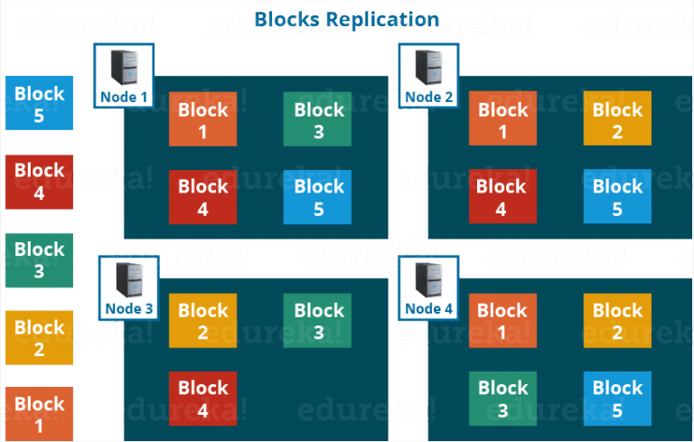
Replication Management
if you are storing a file of 128 MB in HDFS using the default configuration, you will end up occupying a space of 384 MB (3*128 MB) as the blocks will be replicated three times and each replica will be residing on a different DataNode.

Slide 21
NETWORK TOPOLOGY AND HADOOP
What does it mean for two nodes in a local network to be “close” to each other?
Processes on the same node
Different nodes on the same rack
Nodes on different racks in the same data center
Nodes in different data centers

Slide 22
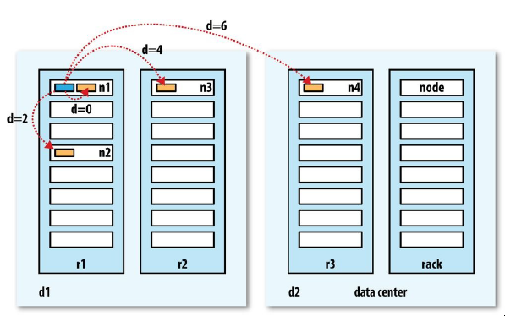

Slide 23
For example, imagine a node n1 on rack r1 in data center d1. This can be represented as /d1/r1/n1. Using this notation, here are the distances for the four scenarios:
distance(/d1/r1/n1, /d1/r1/n1)
= 0 (processes on the same node)
distance(/d1/r1/n1, /d1/r1/n2)
= 2 (different nodes on the same rack)
distance(/d1/r1/n1, /d1/r2/n3)
= 4 (nodes on different racks in the same data center)
distance(/d1/r1/n1, /d2/r3/n4)
= 6 (nodes in different data centers)

Slide 24
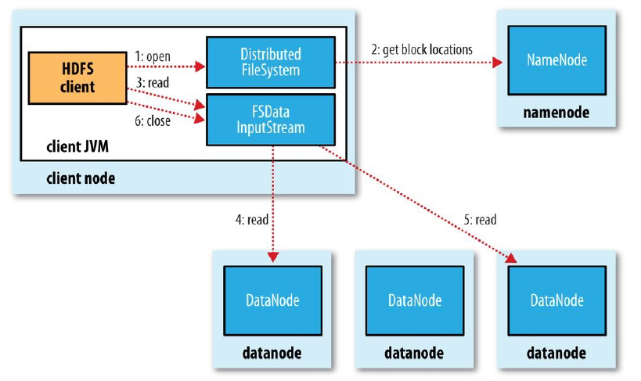
Anatomy of File Read

Slide 25
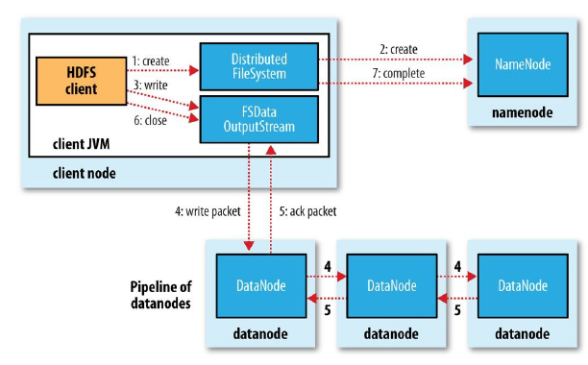
Anatomy of a File Write

Slide 26
Configuration XML files in Hadoop
hadoop-env.sh
This file specifies environment variables that affect the JDK used by Hadoop Daemon (bin/hadoop). (JAVA_HOME)
It informs Hadoop daemon where NameNode runs in the cluster. It contains the configuration settings for Hadoop Core such as I/O settings that are common to HDFS and MapReduce.

Slide 27
hdfs-site.xml
This is the main configuration file for HDFS. It defines the namenode and datanode paths as well as replication factor.
Replication factor is specified by dfs.replication property; as it is a single node cluster hence we will set replication to 1.
The default heartbeat interval is 3 seconds. One can change it by using dfs.heartbeat.interval in hdfs-site.xml.
mapred-site.xml
In order to specify which framework should be used for MapReduce, we use mapreduce.framework.name property, yarn is used here.

Slide 28
yarn-site.xml
In order to specify auxiliary service need to run with nodemanager “yarn.nodemanager.aux-services” property is used.
Here Shuffling is used as auxiliary service. And in order to know the class that should be used for shuffling we user “yarn.nodemanager.aux-services.mapreduce.shuffle.class”
core-site.xml
This file defines port number, memory, memory limits, size of read/write buffers used by Hadoop. Find this file in the etc/hadoop directory
Location of namenode is specified by fs.defaultFS property namenode running at 9000 port on localhost.
hadoop.tmp.dir property to specify the location where temporary as well as permanent data of Hadoop will be stored.

